Slide 1

DIGITAL FORENSICS
DR. NILAKSHI JAIN
Email ID: nilakshijain1986@gmail.com

Slide 2
Introduction To Computer Crimes And Ethical Hacking
1.1 Cybercrime
1.2 Categories of Cybercrimes
1.3 Types of Cybercrimes
1.4 Internet Spawns Crime
1.5 Worms Versus Viruses
1.6 Computer’s Role in Crimes
1.7 Cybercrime Statistics
1.8 Prevention of Cybercrime
1.9 Hacker
1.10 Crackers
1.11 Phreakers
1.12 Ethical Hacking
1.13 Hacking & Ethical Hacking
1.14 Steps of Ethical Hacking
1.15 Tools for Ethical Hacking
1.16 What to Do if Been Hacked?
Chapter One

Slide 3
1.1 Cybercrime
1.2 Categories of Cybercrimes
1.3 Types of Cybercrimes
1.4 Internet Spawns Crime
1.5 Worms Versus Viruses
1.6 Computer’s Role in Crimes
1.7 Cybercrime Statistics
1.8 Prevention of Cybercrime
1.9 Hacker
1.10 Crackers
1.11 Phreakers
1.12 Ethical Hacking
1.13 Hacking & Ethical Hacking
1.14 Steps of Ethical Hacking
1.15 Tools for Ethical Hacking
1.16 What to Do if Been Hacked?
Introduction to Cybercrime
The term cybercrime refers to crimes committed using computer.
Traditionally, cybercrime
refers to the crime involving computer and computer network.
Advanced cybercrime/high-tech crime:
Attacks against computer hardware and software.
Cyber-enabled crime:
Numerous ‘traditional’ crimes have taken a new turn with the arrival of internet, such as crimes against youngsters, monetary crimes, and even acts of terrorism.

Slide 4
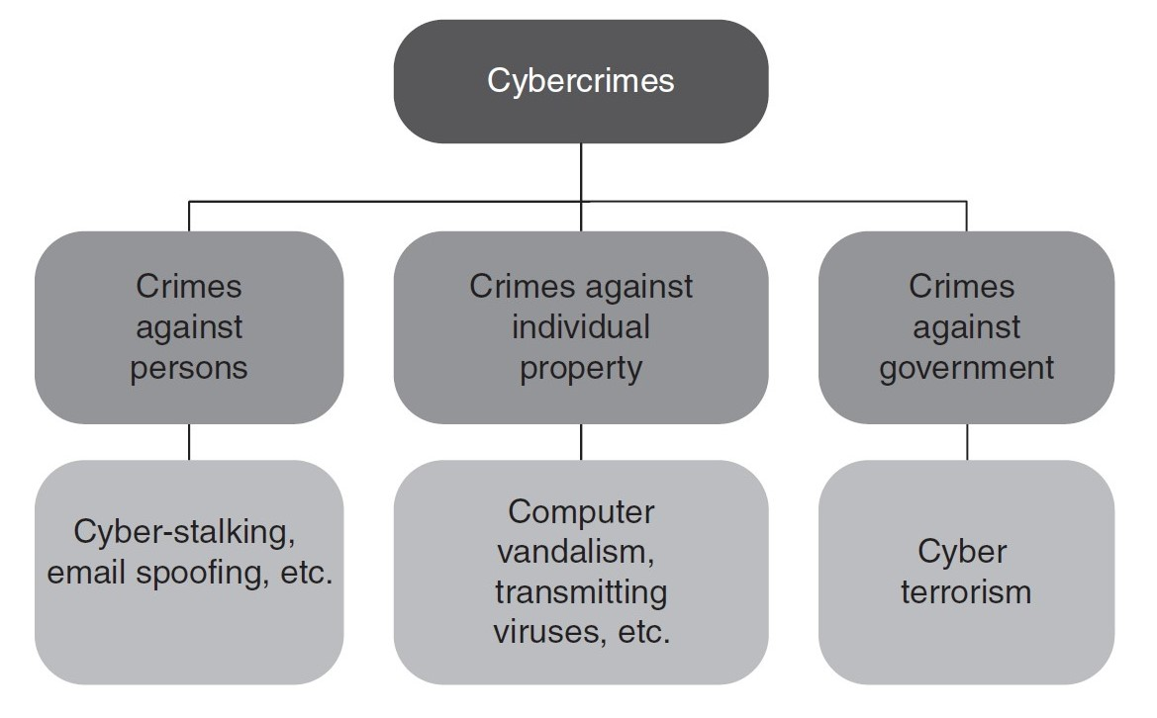
1.1 Cybercrime
1.2 Categories of Cybercrimes
1.3 Types of Cybercrimes
1.4 Internet Spawns Crime
1.5 Worms Versus Viruses
1.6 Computer’s Role in Crimes
1.7 Cybercrime Statistics
1.8 Prevention of Cybercrime
1.9 Hacker
1.10 Crackers
1.11 Phreakers
1.12 Ethical Hacking
1.13 Hacking & Ethical Hacking
1.14 Steps of Ethical Hacking
1.15 Tools for Ethical Hacking
1.16 What to Do if Been Hacked?
1. Cybercrimes Against People :
Cybercrimes committed against people include crimes such as cyber porn, transmission of child pornography, harassment of an individual through email, false legal agreement scams, etc.
2. Cybercrimes Against Property :
Crimes in this category include computer devilry, meaning destruction of others property and transmission of harmful viruses, worms, or programs.
3. Cybercrimes AgainstGovernment
Cyber terrorism is a distinct crime in this category. The spread of internet has shown that this medium is used by people and teams to threaten the
international governments conjointly to terrorize the voters of a rustic.

Slide 5
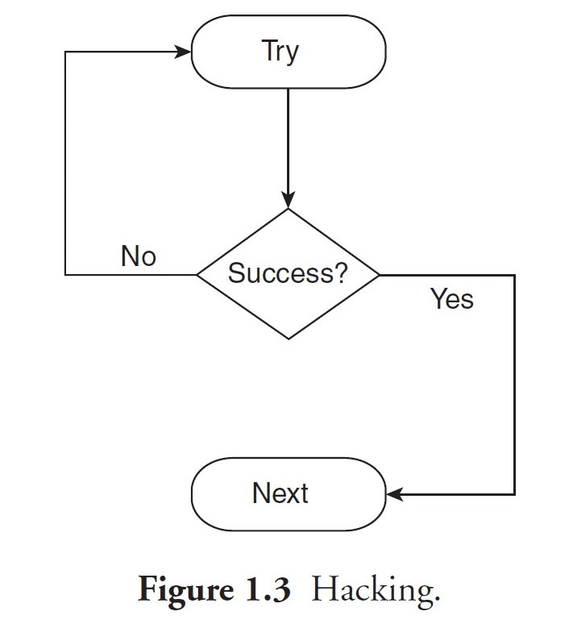
1.1 Cybercrime
1.2 Categories of Cybercrimes
1.3 Types of Cybercrimes
1.4 Internet Spawns Crime
1.5 Worms Versus Viruses
1.6 Computer’s Role in Crimes
1.7 Cybercrime Statistics
1.8 Prevention of Cybercrime
1.9 Hacker
1.10 Crackers
1.11 Phreakers
1.12 Ethical Hacking
1.13 Hacking & Ethical Hacking
1.14 Steps of Ethical Hacking
1.15 Tools for Ethical Hacking
1.16 What to Do if Been Hacked?
Types of Cybercrimes :
A. Violent or potentially violent cybercrimes: Violent or potentially violent cybercrimes are those that
pose a physical risk to some character or people.
B. Non-violent cybercrimes: Non-violent cybercrimes are those that do not directly pose a physical risk
to some character or persons, but indirectly they do pose a risk.
1. Hacking : Do not hack, but when you do, it should be ethical!

Slide 6
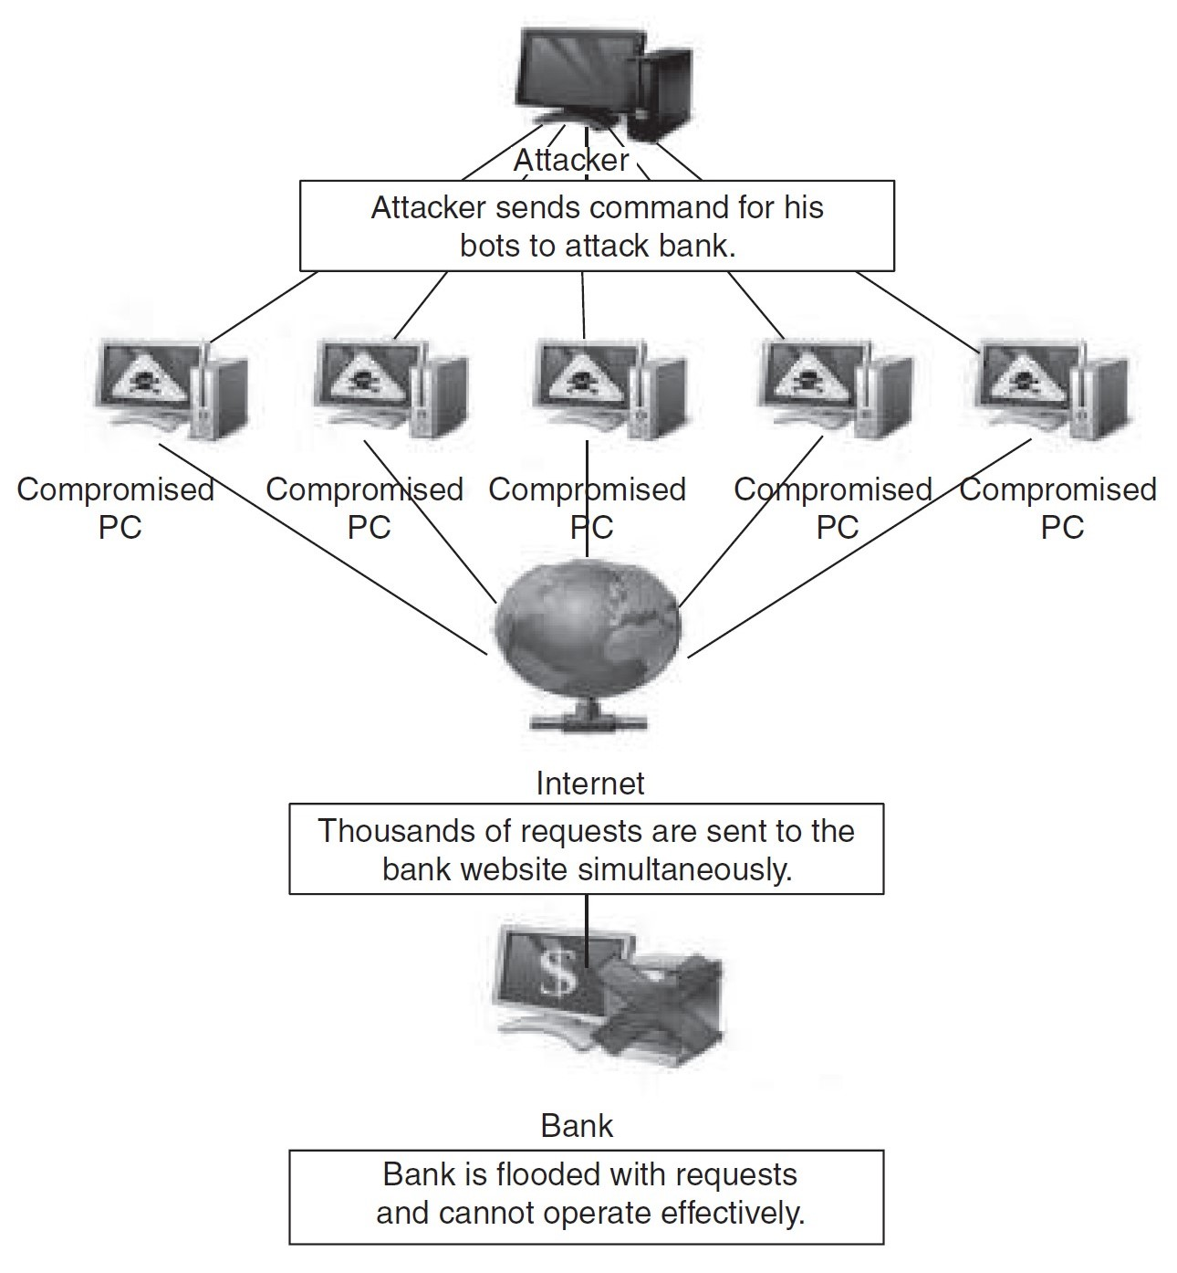
1.1 Cybercrime
1.2 Categories of Cybercrimes
1.3 Types of Cybercrimes
1.4 Internet Spawns Crime
1.5 Worms Versus Viruses
1.6 Computer’s Role in Crimes
1.7 Cybercrime Statistics
1.8 Prevention of Cybercrime
1.9 Hacker
1.10 Crackers
1.11 Phreakers
1.12 Ethical Hacking
1.13 Hacking & Ethical Hacking
1.14 Steps of Ethical Hacking
1.15 Tools for Ethical Hacking
1.16 What to Do if Been Hacked?
Types of Cybercrimes :
2. Denial-of-Service Attacks :
A Denial-of-Service (DoS) attack is a trial to make an online service unavailable by overloading the network
traffic from multiple sources. DoS targets a large variety of resources

Slide 7
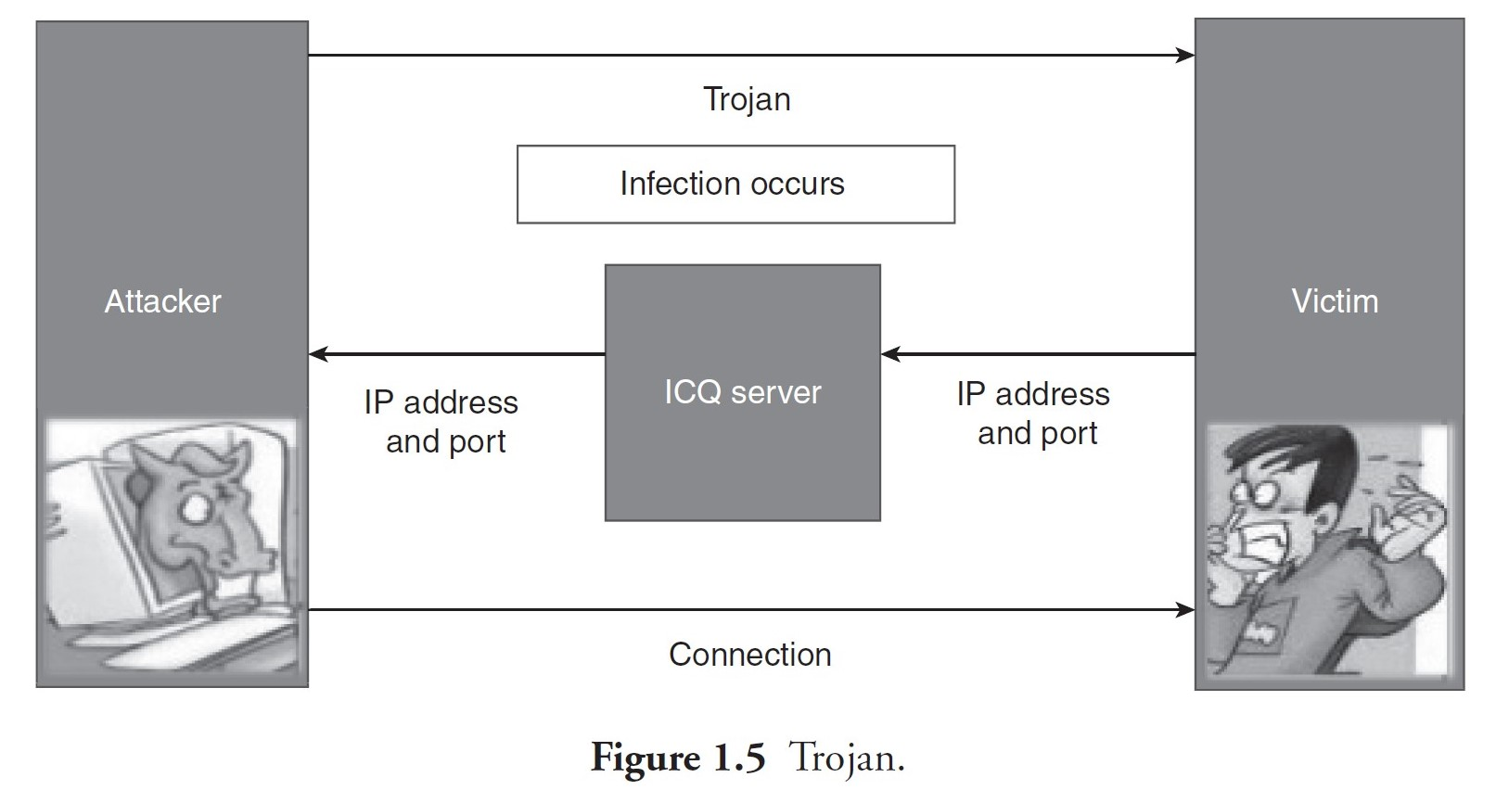
1.1 Cybercrime
1.2 Categories of Cybercrimes
1.3 Types of Cybercrimes
1.4 Internet Spawns Crime
1.5 Worms Versus Viruses
1.6 Computer’s Role in Crimes
1.7 Cybercrime Statistics
1.8 Prevention of Cybercrime
1.9 Hacker
1.10 Crackers
1.11 Phreakers
1.12 Ethical Hacking
1.13 Hacking & Ethical Hacking
1.14 Steps of Ethical Hacking
1.15 Tools for Ethical Hacking
1.16 What to Do if Been Hacked?
Types of Cybercrimes :
3. Trojan Attacks :
Trojans are small particles of malware that allow the hacker to either gain or obtain remote access to any
computer.
4. Credit Card Frauds :
Credit card frauds usually occur when an individual discloses his/her confidential data such as credit card
number, CVV number, secret code for transaction, expiry date, etc.

Slide 8
1.1 Cybercrime
1.2 Categories of Cybercrimes
1.3 Types of Cybercrimes
1.4 Internet Spawns Crime
1.5 Worms Versus Viruses
1.6 Computer’s Role in Crimes
1.7 Cybercrime Statistics
1.8 Prevention of Cybercrime
1.9 Hacker
1.10 Crackers
1.11 Phreakers
1.12 Ethical Hacking
1.13 Hacking & Ethical Hacking
1.14 Steps of Ethical Hacking
1.15 Tools for Ethical Hacking
1.16 What to Do if Been Hacked?
Types of Cybercrimes :
5. Cyber Pornography : Cyber pornography refers to distributing pornography over the internet. People create and distribute porn or obscene materials over the internet.
6. Online Betting : Online betting is also called online gambling or internet gambling and takes place over the internet. Online gambling is the basic term used for gambling over the internet.
7. Software Piracy : Software piracy refers to the act of distributing licensed or paid or copyrighted software for free or at a minimal cost over the internet.
8. E-mail Spoofing : Email spoofing refers to sending emails from an unknown or false source. Spoofing means that the hacker sends an email from your email address.
9. Forgery/Falsification : Forgery refers to the action of forging a copy or imitation of a document, signature, or banknote. It is done to earn a huge profit by selling the forged resource.

Slide 9
1.1 Cybercrime
1.2 Categories of Cybercrimes
1.3 Types of Cybercrimes
1.4 Internet Spawns Crime
1.5 Worms Versus Viruses
1.6 Computer’s Role in Crimes
1.7 Cybercrime Statistics
1.8 Prevention of Cybercrime
1.9 Hacker
1.10 Crackers
1.11 Phreakers
1.12 Ethical Hacking
1.13 Hacking & Ethical Hacking
1.14 Steps of Ethical Hacking
1.15 Tools for Ethical Hacking
1.16 What to Do if Been Hacked?
Types of Cybercrimes :
10. Phishing : Phishing is a fraud type wherein the hacker tries to get personal information, including login credentials or any bank account information, by pretending to be a genuine entity in email, messages, or other communication
channels.
11. Cyber Terrorism : Cyber terrorism is a planned activity in the cyber space via computer networks. It includes the use of email as a communication medium.
12. Salami Attacks : Salami attack is a combination of many small attacks that can go undetected due to the nature of cybercrime.
13. Defamation : Internet is an integral part of our life. It acts as a medium for interacting with people across the globe. Defamation implies causing harm to a reputed individual in front of others.
14. Cyber Stalking : Cyber stalking refers to the use of an electronic medium to threaten someone or an individual or a group of people or certain organization.

Slide 10
1.1 Cybercrime
1.2 Categories of Cybercrimes
1.3 Types of Cybercrimes
1.4 Internet Spawns Crime
1.5 Worms Versus Viruses
1.6 Computer’s Role in Crimes
1.7 Cybercrime Statistics
1.8 Prevention of Cybercrime
1.9 Hacker
1.10 Crackers
1.11 Phreakers
1.12 Ethical Hacking
1.13 Hacking & Ethical Hacking
1.14 Steps of Ethical Hacking
1.15 Tools for Ethical Hacking
1.16 What to Do if Been Hacked?
The Internet Spawns Crime :
The internet is a network of communication and content services that is globally accessible. As internet provides a lot of options for buying and selling, crimes are on the rise in this environment. A computer represents a tool of crime as in murder or fraud, the object of crime as in stealing of processor chips, or the theme of crime as in hacking and spreading viruses.

Slide 11
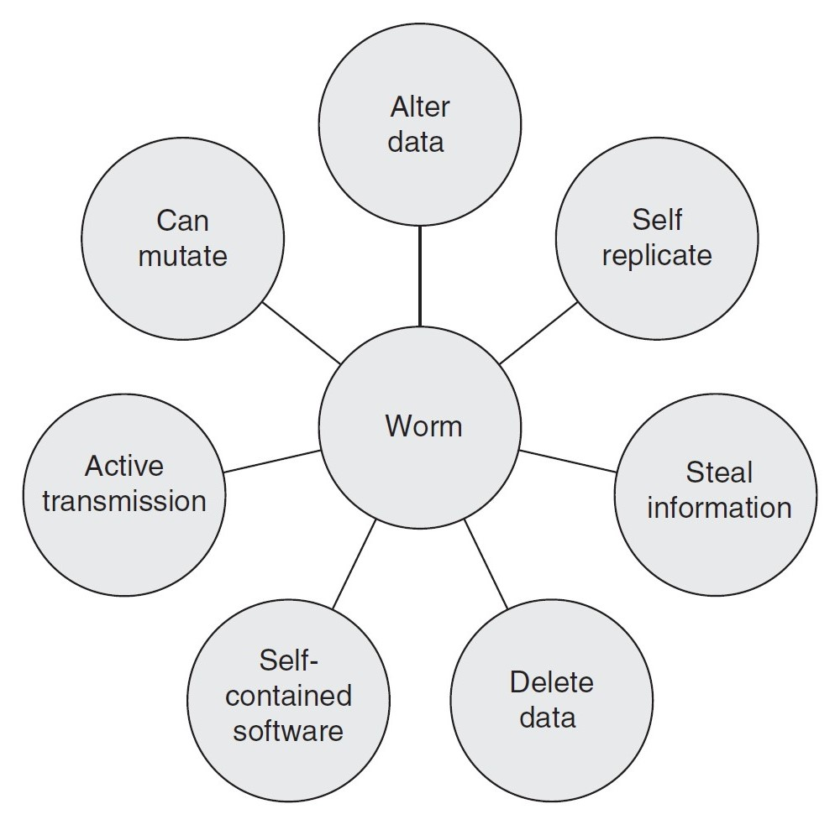
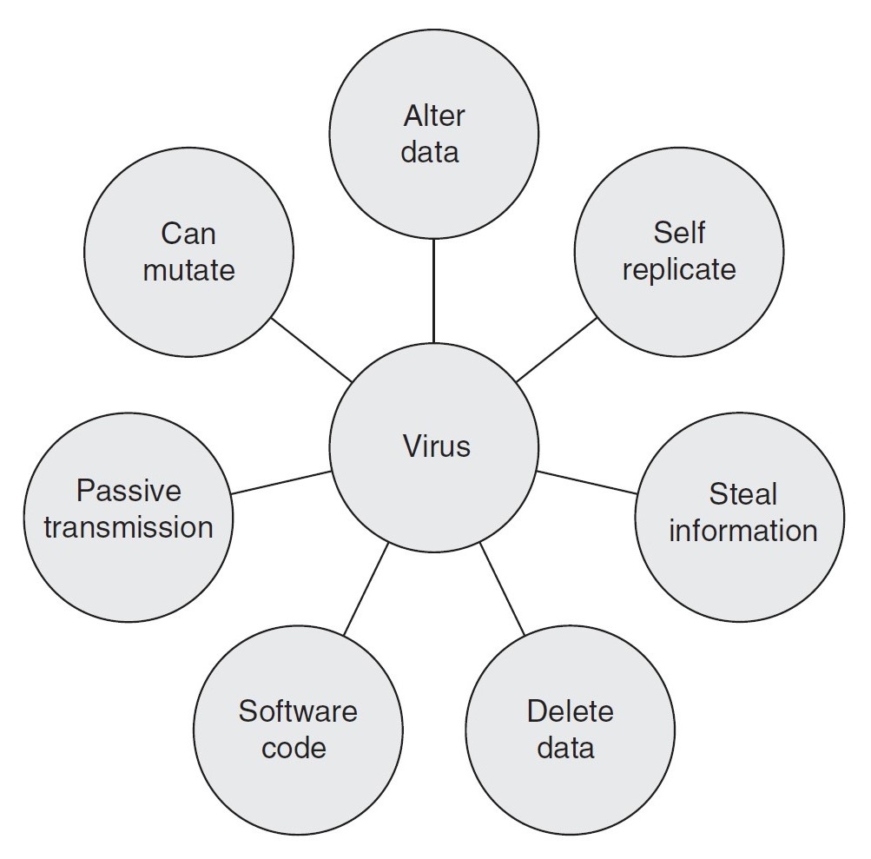
1.1 Cybercrime
1.2 Categories of Cybercrimes
1.3 Types of Cybercrimes
1.4 Internet Spawns Crime
1.5 Worms Versus Viruses
1.6 Computer’s Role in Crimes
1.7 Cybercrime Statistics
1.8 Prevention of Cybercrime
1.9 Hacker
1.10 Crackers
1.11 Phreakers
1.12 Ethical Hacking
1.13 Hacking & Ethical Hacking
1.14 Steps of Ethical Hacking
1.15 Tools for Ethical Hacking
1.16 What to Do if Been Hacked?
Worms Versus Viruses :
Worms and viruses are malicious programs that can cause harm to our system. However, both these terms
are very different.
1. Worms : A worm (write once read many) is similar to a computer virus by design. It is considered to be a secondary category of virus. A worm spreads from computer to computer, but unlike virus it has the capability to travel without any human action.
2. Viruses : A virus (vital information resources under siege) is a software that is designed to duplicate itself. This is
done by replicating itself into various programs that are stored in the computer.

Slide 12
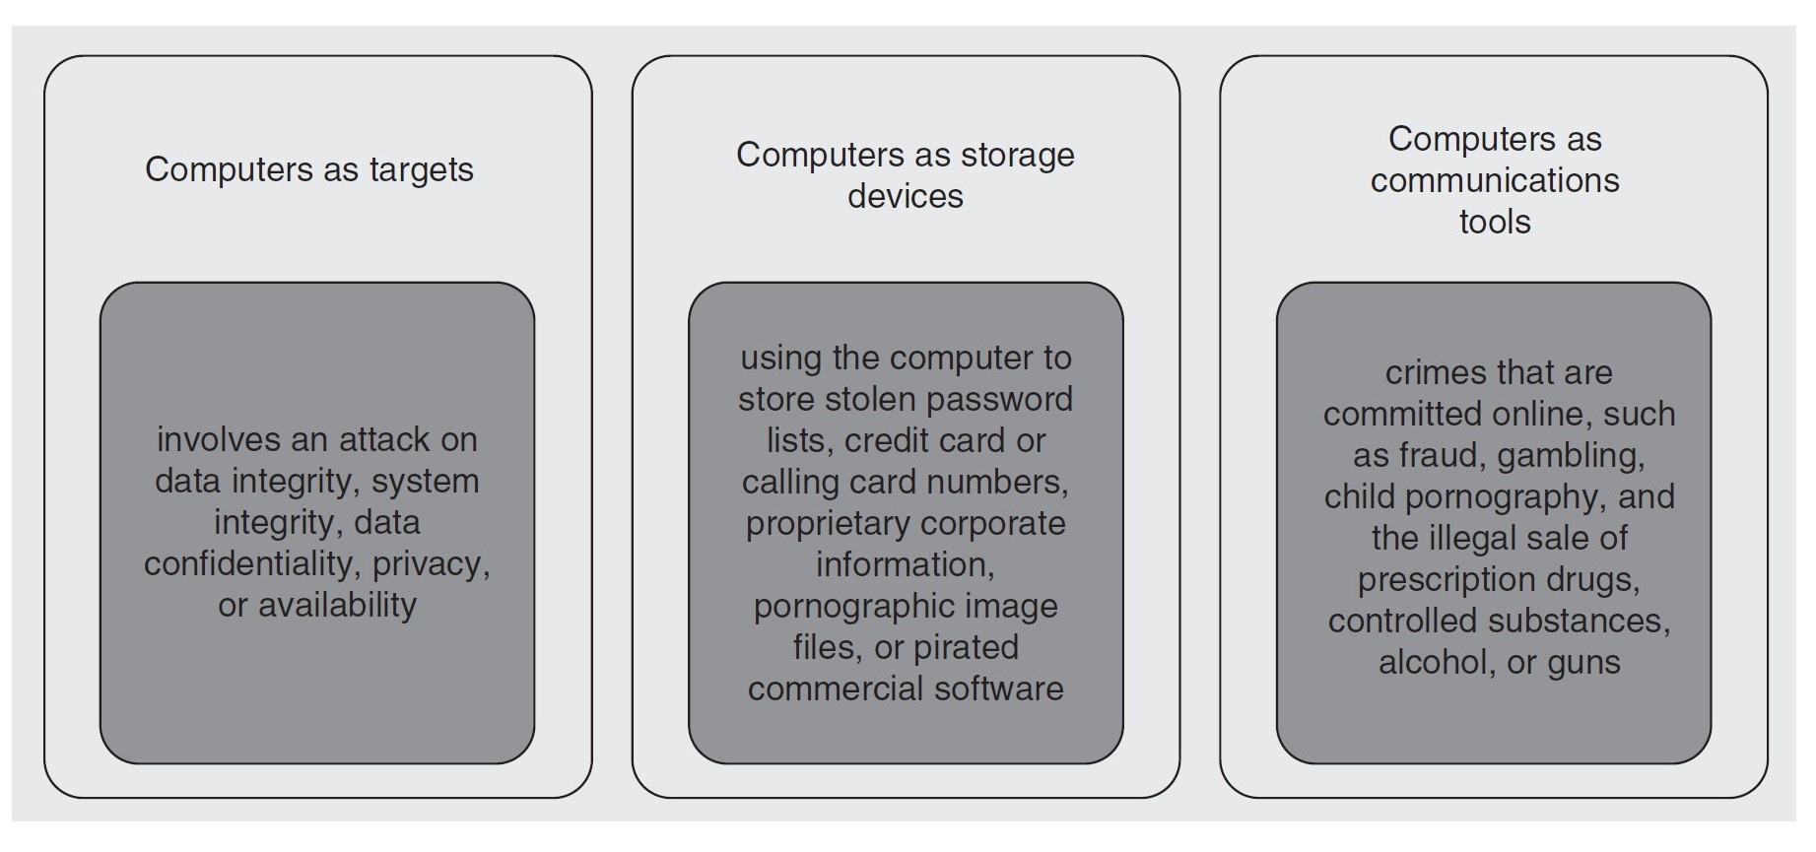
1.1 Cybercrime
1.2 Categories of Cybercrimes
1.3 Types of Cybercrimes
1.4 Internet Spawns Crime
1.5 Worms Versus Viruses
1.6 Computer’s Role in Crimes
1.7 Cybercrime Statistics
1.8 Prevention of Cybercrime
1.9 Hacker
1.10 Crackers
1.11 Phreakers
1.12 Ethical Hacking
1.13 Hacking & Ethical Hacking
1.14 Steps of Ethical Hacking
1.15 Tools for Ethical Hacking
1.16 What to Do if Been Hacked?
Computer’s Role in Crimes :
Computers can play a vital role in crimes as shown in Figure . They can extract evidences, instrumentality, illegal imports, or the fruit of a crime.
1. They can act as a communication tool.
2. They can be the target of the attacker for criminal activity.
3. They can also be tangential to crime.

Slide 13
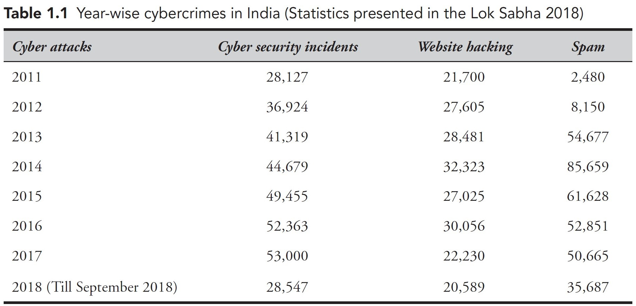
1.1 Cybercrime
1.2 Categories of Cybercrimes
1.3 Types of Cybercrimes
1.4 Internet Spawns Crime
1.5 Worms Versus Viruses
1.6 Computer’s Role in Crimes
1.7 Cybercrime Statistics
1.8 Prevention of Cybercrime
1.9 Hacker
1.10 Crackers
1.11 Phreakers
1.12 Ethical Hacking
1.13 Hacking & Ethical Hacking
1.14 Steps of Ethical Hacking
1.15 Tools for Ethical Hacking
1.16 What to Do if Been Hacked?
Cybercrime Statistics in India :
Total cybercrimes, including fishing malicious code, website intrusion, denial of service, scanning, etc., that occurred in the last eight years are given in Table

Slide 14
1.1 Cybercrime
1.2 Categories of Cybercrimes
1.3 Types of Cybercrimes
1.4 Internet Spawns Crime
1.5 Worms Versus Viruses
1.6 Computer’s Role in Crimes
1.7 Cybercrime Statistics
1.8 Prevention of Cybercrime
1.9 Hacker
1.10 Crackers
1.11 Phreakers
1.12 Ethical Hacking
1.13 Hacking & Ethical Hacking
1.14 Steps of Ethical Hacking
1.15 Tools for Ethical Hacking
1.16 What to Do if Been Hacked?
Prevention of Cybercrime :
Prevention is always better than cure. It is always better to take certain precautions while working on the internet.
The 5P’s mantra for online security are as follows:
1. Precaution
2. Prevention
3. Protection
4. Preservation
5. Perseverance

Slide 15

1.1 Cybercrime
1.2 Categories of Cybercrimes
1.3 Types of Cybercrimes
1.4 Internet Spawns Crime
1.5 Worms Versus Viruses
1.6 Computer’s Role in Crimes
1.7 Cybercrime Statistics
1.8 Prevention of Cybercrime
1.9 Hacker
1.10 Crackers
1.11 Phreakers
1.12 Ethical Hacking
1.13 Hacking & Ethical Hacking
1.14 Steps of Ethical Hacking
1.15 Tools for Ethical Hacking
1.16 What to Do if Been Hacked?
Definition of Hacker :
The one who is curious about the workings of any computer software is termed a hacker. Very often, the hackers are a unit of smart programmers.
Hackers have advanced knowledge of operative systems and programming languages.

Slide 16
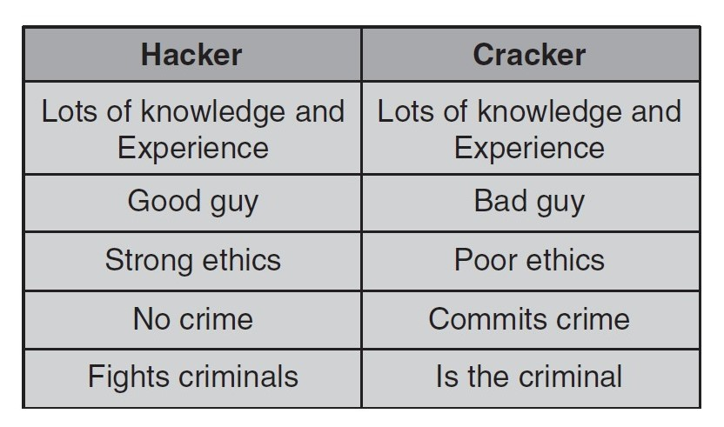
1.1 Cybercrime
1.2 Categories of Cybercrimes
1.3 Types of Cybercrimes
1.4 Internet Spawns Crime
1.5 Worms Versus Viruses
1.6 Computer’s Role in Crimes
1.7 Cybercrime Statistics
1.8 Prevention of Cybercrime
1.9 Hacker
1.10 Crackers
1.11 Phreakers
1.12 Ethical Hacking
1.13 Hacking & Ethical Hacking
1.14 Steps of Ethical Hacking
1.15 Tools for Ethical Hacking
1.16 What to Do if Been Hacked?
Definition of Cracker :
People who break into different systems with malicious intentions are referred to as crackers.
Crackers cause issues to victims by an unauthorized access, destroying necessary information, stopping services provided by the server, and more.

Slide 17
1.1 Cybercrime
1.2 Categories of Cybercrimes
1.3 Types of Cybercrimes
1.4 Internet Spawns Crime
1.5 Worms Versus Viruses
1.6 Computer’s Role in Crimes
1.7 Cybercrime Statistics
1.8 Prevention of Cybercrime
1.9 Hacker
1.10 Crackers
1.11 Phreakers
1.12 Ethical Hacking
1.13 Hacking & Ethical Hacking
1.14 Steps of Ethical Hacking
1.15 Tools for Ethical Hacking
1.16 What to Do if Been Hacked?
Definition of Phreakers :
Phreaker is the one who gains illegal access to the telephone system as shown in Figure.
Phreakers are considered the original computer hackers and they are those who break into the telephone network illegally, typically to make free long distance phone calls or to tap phone lines. Phreakers are people who specialize in attacks on the telephone system.

Slide 18
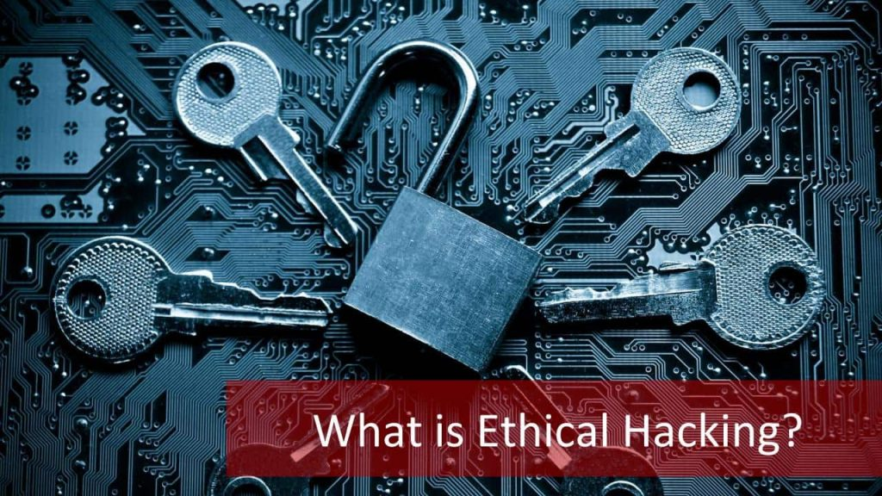
1.1 Cybercrime
1.2 Categories of Cybercrimes
1.3 Types of Cybercrimes
1.4 Internet Spawns Crime
1.5 Worms Versus Viruses
1.6 Computer’s Role in Crimes
1.7 Cybercrime Statistics
1.8 Prevention of Cybercrime
1.9 Hacker
1.10 Crackers
1.11 Phreakers
1.12 Ethical Hacking
1.13 Hacking & Ethical Hacking
1.14 Steps of Ethical Hacking
1.15 Tools for Ethical Hacking
1.16 What to Do if Been Hacked?
Ethical Hacking :
Hacking is typically done to achieve unauthorized access to a system or an electronic network, either to hurt the systems or to steal sensitive data out there on the pc. Hacking is typically legal as long as
it is being done to seek out weaknesses in a pc or network system for testing purpose. This type of hacking is what we have a tendency to decision moral hacking or in other words Ethical Hacking.

Slide 19
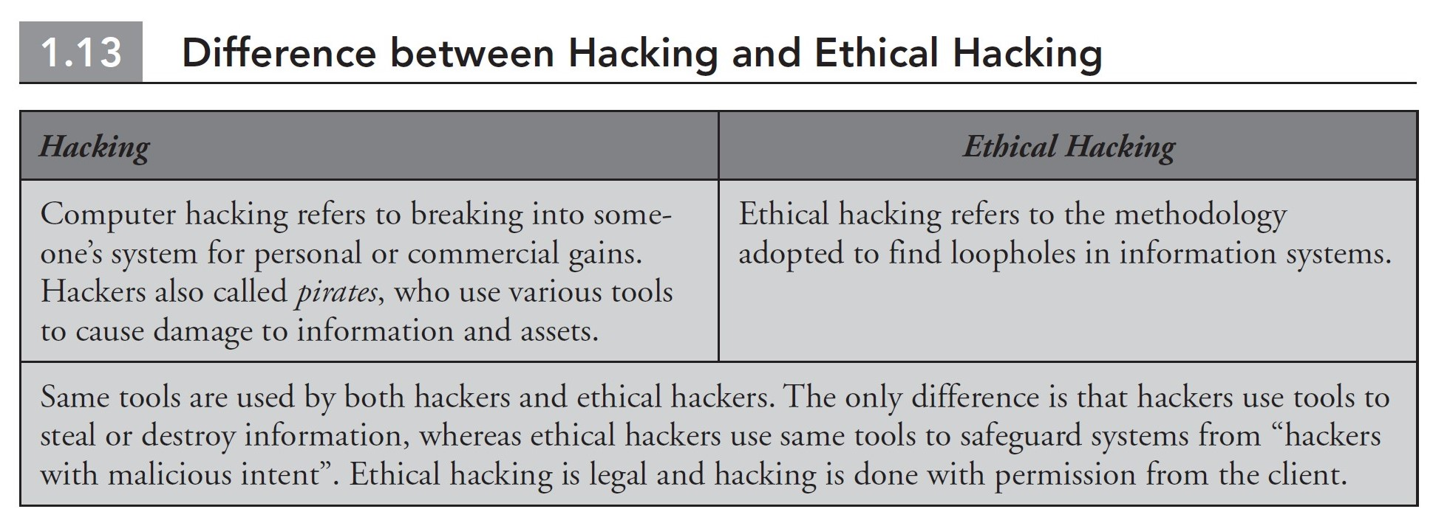
1.1 Cybercrime
1.2 Categories of Cybercrimes
1.3 Types of Cybercrimes
1.4 Internet Spawns Crime
1.5 Worms Versus Viruses
1.6 Computer’s Role in Crimes
1.7 Cybercrime Statistics
1.8 Prevention of Cybercrime
1.9 Hacker
1.10 Crackers
1.11 Phreakers
1.12 Ethical Hacking
1.13 Hacking & Ethical Hacking
1.14 Steps of Ethical Hacking
1.15 Tools for Ethical Hacking
1.16 What to Do if Been Hacked?
Difference between Hacking & Ethical Hacking :

Slide 20
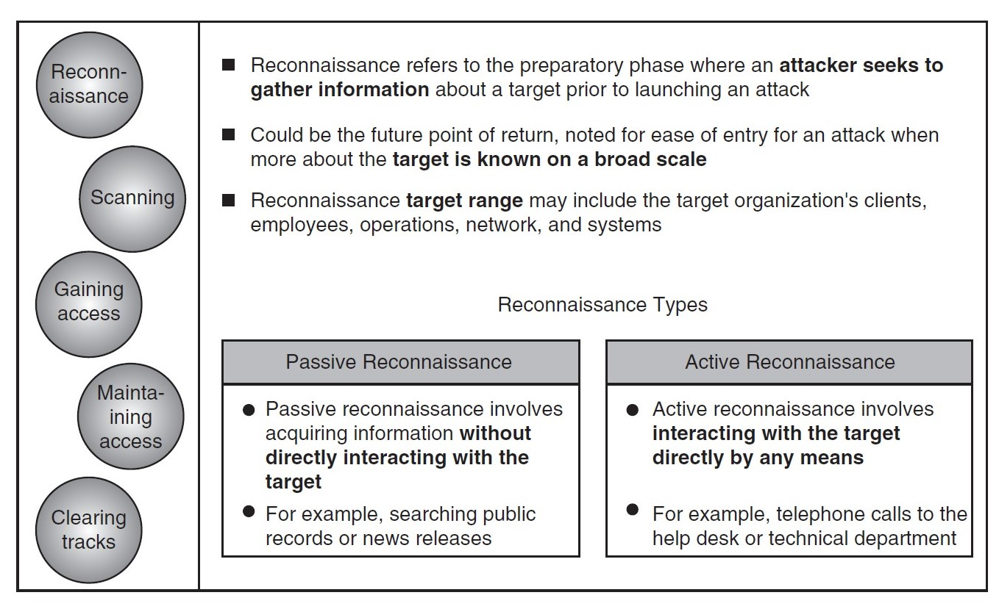
1.1 Cybercrime
1.2 Categories of Cybercrimes
1.3 Types of Cybercrimes
1.4 Internet Spawns Crime
1.5 Worms Versus Viruses
1.6 Computer’s Role in Crimes
1.7 Cybercrime Statistics
1.8 Prevention of Cybercrime
1.9 Hacker
1.10 Crackers
1.11 Phreakers
1.12 Ethical Hacking
1.13 Hacking & Ethical Hacking
1.14 Steps of Ethical Hacking
1.15 Tools for Ethical Hacking
1.16 What to Do if Been Hacked?
Steps of Ethical Hacking :
1. Reconnaissance :
Reconnaissance is the phase where the attacker gathers information about a target using active or passive
means as shown in Figure.
The tools that are widely used in this process are NMAP, Hping, Maltego,
and Google Dorks

Slide 21
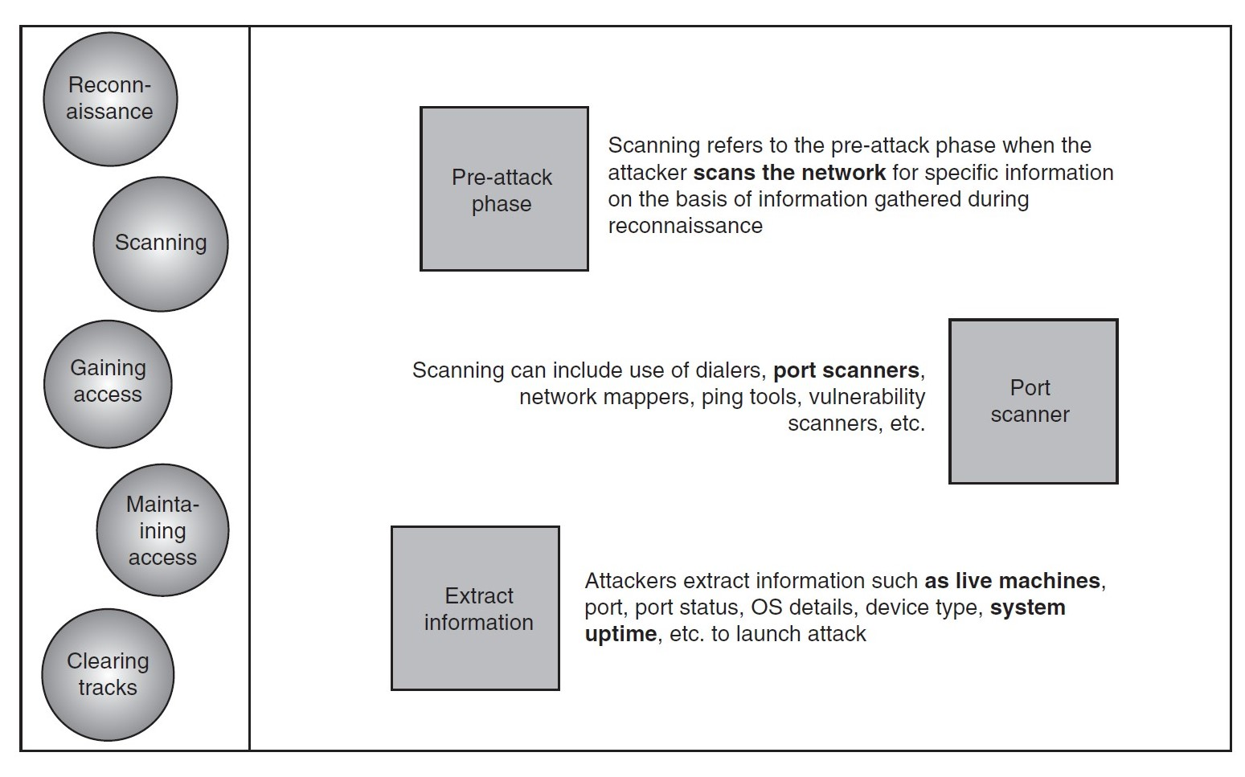
1.1 Cybercrime
1.2 Categories of Cybercrimes
1.3 Types of Cybercrimes
1.4 Internet Spawns Crime
1.5 Worms Versus Viruses
1.6 Computer’s Role in Crimes
1.7 Cybercrime Statistics
1.8 Prevention of Cybercrime
1.9 Hacker
1.10 Crackers
1.11 Phreakers
1.12 Ethical Hacking
1.13 Hacking & Ethical Hacking
1.14 Steps of Ethical Hacking
1.15 Tools for Ethical Hacking
1.16 What to Do if Been Hacked?
Steps of Ethical Hacking :
2. Scanning :
In scanning, the attacker begins to actively probe a target machine or network for vulnerabilities that can
be exploited as shown in Figure .
The tools used in this process are Nessus, Nexpose, Wireshark, and
NMAP

Slide 22
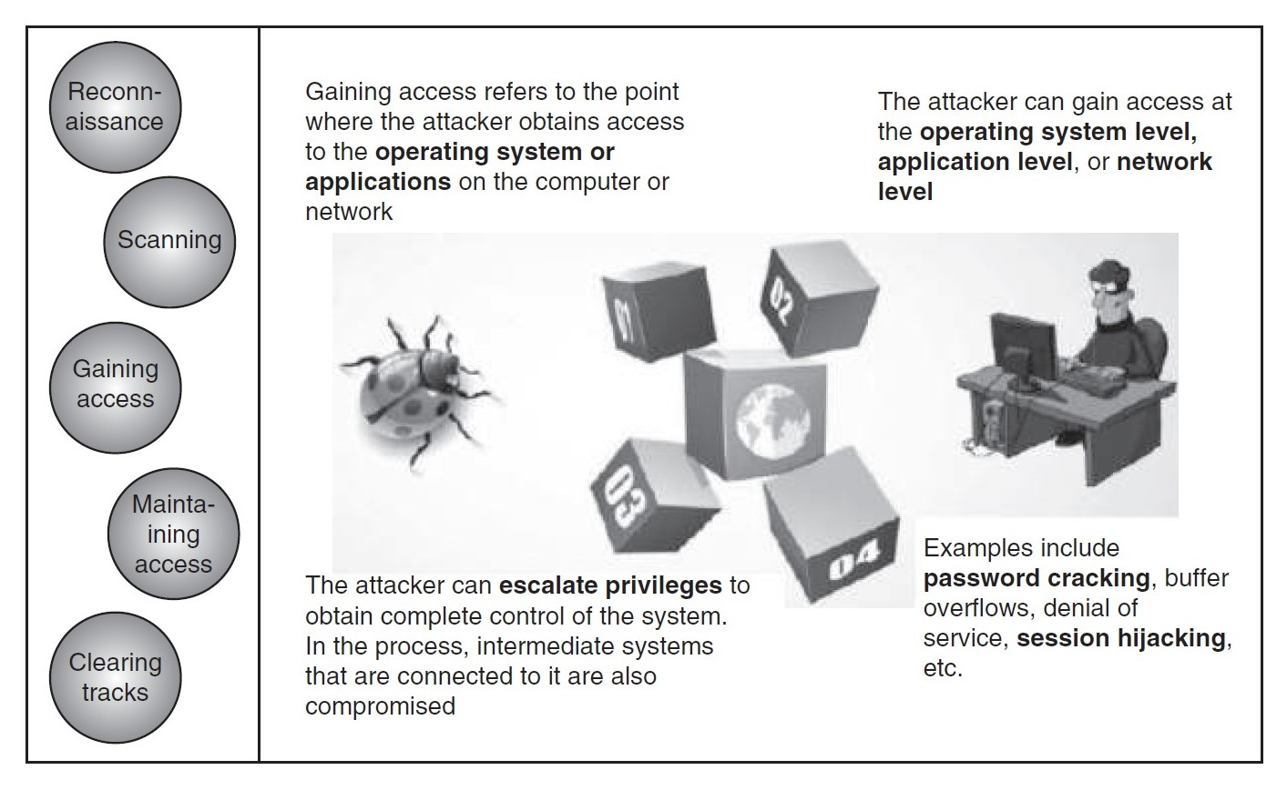
1.1 Cybercrime
1.2 Categories of Cybercrimes
1.3 Types of Cybercrimes
1.4 Internet Spawns Crime
1.5 Worms Versus Viruses
1.6 Computer’s Role in Crimes
1.7 Cybercrime Statistics
1.8 Prevention of Cybercrime
1.9 Hacker
1.10 Crackers
1.11 Phreakers
1.12 Ethical Hacking
1.13 Hacking & Ethical Hacking
1.14 Steps of Ethical Hacking
1.15 Tools for Ethical Hacking
1.16 What to Do if Been Hacked?
Steps of Ethical Hacking :
3. Gaining Access :
In this process, the vulnerability is located and you attempt to exploit it in order to enter into the system as
shown in Figure.
The primary tool that is used in this process is Metasploit.

Slide 23
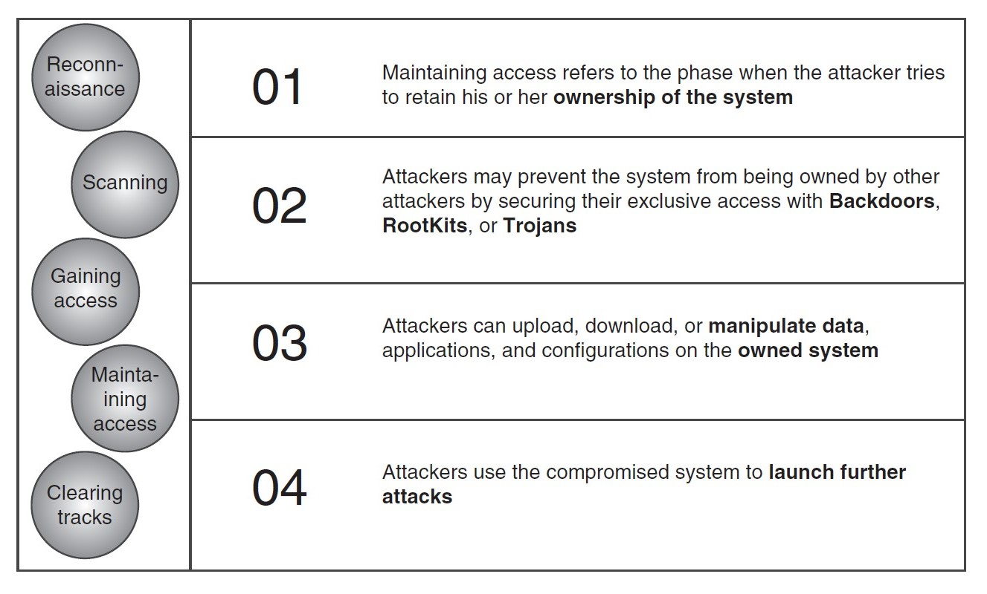
1.1 Cybercrime
1.2 Categories of Cybercrimes
1.3 Types of Cybercrimes
1.4 Internet Spawns Crime
1.5 Worms Versus Viruses
1.6 Computer’s Role in Crimes
1.7 Cybercrime Statistics
1.8 Prevention of Cybercrime
1.9 Hacker
1.10 Crackers
1.11 Phreakers
1.12 Ethical Hacking
1.13 Hacking & Ethical Hacking
1.14 Steps of Ethical Hacking
1.15 Tools for Ethical Hacking
1.16 What to Do if Been Hacked?
Steps of Ethical Hacking :
4. Maintaining Access :
It is the process where the hacker has already gained access into a system as shown in Figure. After gaining access, the hacker installs some backdoors in order to enter into the system when he/she needs access in this owned system in future. Metasploit is the preferred tool in this process.

Slide 24
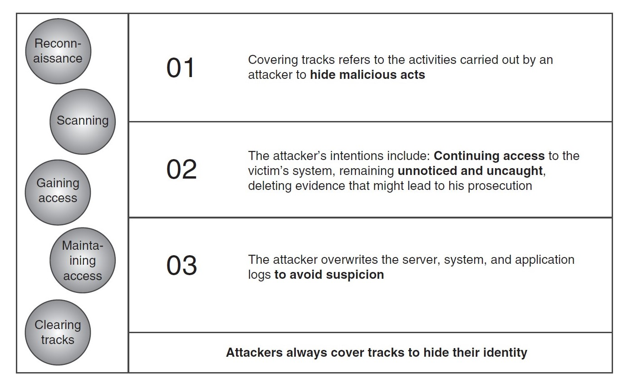
1.1 Cybercrime
1.2 Categories of Cybercrimes
1.3 Types of Cybercrimes
1.4 Internet Spawns Crime
1.5 Worms Versus Viruses
1.6 Computer’s Role in Crimes
1.7 Cybercrime Statistics
1.8 Prevention of Cybercrime
1.9 Hacker
1.10 Crackers
1.11 Phreakers
1.12 Ethical Hacking
1.13 Hacking & Ethical Hacking
1.14 Steps of Ethical Hacking
1.15 Tools for Ethical Hacking
1.16 What to Do if Been Hacked?
Steps of Ethical Hacking :
5. Clearing Tracks :
This process is actually an unethical activity. It has to do with the deletion of logs of all the activities that take place during the hacking process as shown in Figure.

Slide 25
1.1 Cybercrime
1.2 Categories of Cybercrimes
1.3 Types of Cybercrimes
1.4 Internet Spawns Crime
1.5 Worms Versus Viruses
1.6 Computer’s Role in Crimes
1.7 Cybercrime Statistics
1.8 Prevention of Cybercrime
1.9 Hacker
1.10 Crackers
1.11 Phreakers
1.12 Ethical Hacking
1.13 Hacking & Ethical Hacking
1.14 Steps of Ethical Hacking
1.15 Tools for Ethical Hacking
1.16 What to Do if Been Hacked?
Exploring some Tools for Ethical Hacking
1. Reconnaissance Tools :
a. Nmap : Nmap or “Network Mapper” is one of the most popular and widely used security auditing tools.
b. Google Dorks : While investigating people or companies, a lot of IT security newbies forget the importance of using traditional search engines for recon and intel gathering. In this case, Google Dorks can be your best friend.
c. Maltego : It is a tremendous tool to trace down footprints of any target you wish to match.
2. Scanning Tools :
a. Nexpose : Nexpose vulnerability scanner, developed by Rapid7, which is an open-source tool is developed by Rapid7
isand is used to scan the vulnerabilities and performs various network checks
b. Wireshark : Wireshark is the world’s leading and extensively used network protocol analyzer.
c. Nessus : Wireshark is the world’s leading and extensively used network protocol analyzer.

Slide 26
1.1 Cybercrime
1.2 Categories of Cybercrimes
1.3 Types of Cybercrimes
1.4 Internet Spawns Crime
1.5 Worms Versus Viruses
1.6 Computer’s Role in Crimes
1.7 Cybercrime Statistics
1.8 Prevention of Cybercrime
1.9 Hacker
1.10 Crackers
1.11 Phreakers
1.12 Ethical Hacking
1.13 Hacking & Ethical Hacking
1.14 Steps of Ethical Hacking
1.15 Tools for Ethical Hacking
1.16 What to Do if Been Hacked?
What to do if Been Hacked ?
1. Cut-off your internet connection: If you think that you simply are being hacked, the primary factor to try to do is to cut-off internet from your system so as to prevent any more intrusion.
2. Turn on firewall: Typically, we have a tendency to close up windows firewall so as to put in some package. From a security purpose of read , forever we must always activate firewalls. Hardware firewall is another smart choice to install. It acts as an associate isolator between external network and your internal systems.
3. Contact your internet service supplier: It’s a decent apply to contact your ISP within the case of hacking as a result of they need their own policy and pointers for any malicious intrusion.

Slide 27
Dr. Nilakshi Jain
Thank you
Email ID : nilakshijain1986@gmail.com

